Slide 1



Professional Style PowerPoint
Template by Hubspot

Slide 2

How to Use This Template:
Thanks for downloading this resource.
Use this presentation as a guide/inspiration for your own PowerPoints. Format the presentation using your brand’s colors, fonts, images, and style.
Add new slides using the “New Slide” button in the toolbar.
These templates are for both Mac and PC users, but if anything shows up a little funky or misaligned, just adjust to the slide and shift around anything that may appear different.
Use the elements you need. If you like a text box or layout from one slide, copy & paste it onto another and mix and match designs.
Notes:
Please watch all videos above.

Slide 3

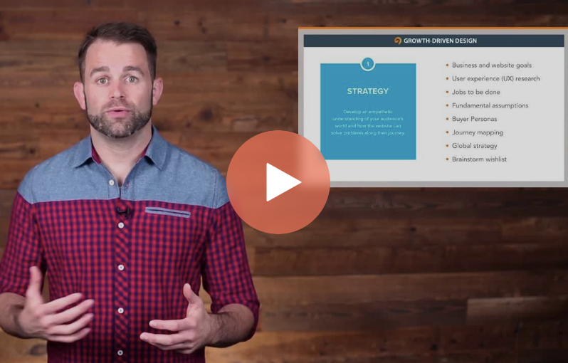
Sharpen your skills
With HubSpot Academy
Take free courses on Inbound Marketing, Sales, and Customer Service
Visit https://bit.ly/3auUHUl to Get Started Free
Notes:
Product Screenshot Full MacBook

Slide 4



Nice to meet you.
Presenter Patricia
Chief Marketing Officer, Our Brand @PresenterPatty

Slide 5





Introductions Q1 Recap
Creative Brainstorming Strategy Discussion Review & Assign

Slide 6


Slide Section Title

Slide 7
Introductions
Start the meeting off strong with personal intros. By getting to know those you’ll be working with, you’ll have a smoother meeting.

Slide 8



Use photography to create a visually dynamic and interesting presentation. Try websites like Unsplash.com or the free stock photos in HubSpot’s Marketing Hub.

Slide 9
“Nothing sticks in your head better than a story. Stories can express the most complicated ideas in the most digestible ways.”
Sam Balter | Sr. Marketing Manager of Podcasts | HubSpot

Slide 10
Content marketing gets three times more leads than paid advertising.
Source: Content Marketing Institute, 2017

Slide 11

Quarter | Revenue Earned | Revenue Goal | Hit/Missed Goal
Q2 2018 | $52,654 | $55,000
Q3 2018 | $56,672 | $60,000
Q4 2018 | $65,213 | $65,000
Q1 2019 | $72,359 | $70,000
Revenue Tracking
2018 – 2019

Slide 12
Content Slide
A slide for general content.
Don’t write down everything you’re going to say and try to avoid walls of text. Include pertinent information, statistics, and data visualizations, and walk through the rest verbally.
Incorporate bullet points to break up slides
Leave plenty of white space
Leverage bold and italics to emphasize points

Slide 13

Grow your traffic, convert leads, and prove ROI with our all-in-one marketing software.
Visit bit.ly/2zfjZD4 for a free demo
Template by Hubspot

